Slide 1
CSS Exercise

Slide 2
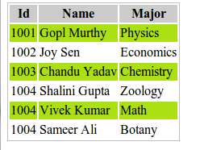
Question-1
Create a CSS3 Zebra Striping a Table.
On completion, the page will look like following

Slide 3
Question-2
Given the table in the html code in the question style the table so that the odd rows have a light gray background In addition and a header row to the table and style that row so it has white text and a black background color. Change the font so that they are all 14 point sans serif of some kind.

Slide 4
Question-3
Write a external css file with following :
Style text in <h1> to uppercase letters, and text in <p> to capitalized letters. Set "gradient_bg_vertical.png" as the background image of the page, and repeat it vertically only. Use the margin property to set the top and bottom margins for <h1> to "50px", and left and right margins to "25px".

Slide 5
Question-4
Set a "4px", "dotted" border for <p>. set the border color for <p> to "red".
Set the <p> to "italic", "20px" and "Verdana".

